Slide 1

INT 306
Database Management Systems
LECTURE 4
‘ LET’S MOVE TOWARD THE BETTER WAY TO STORE AND MANAGE THE DATA’

Slide 2
Entity/Relationship
Modelling
COURSE WORK
STUDENT
DOES

Slide 3
Database Design
Before we look at how to create and use a database we’ll look at how to design one
Need to consider
What tables, keys, and constraints are needed?
What is the database going to be used for?
Conceptual design
Build a model independent of
the choice of DBMS
Logical design
Create the database in a given
DBMS
Physical design
How the database is stored in
hardware

Slide 4
Entity/Relationship Modelling
E/R Modelling is used for conceptual design
Entities - objects or items of interest
Attributes - facts about, or
properties of, an entity
Relationships - links between entities
Example
In a University database we might have entities for Students, Modules and Lecturers. Students might have attributes such as their ID, Name, and Course, and could have relationships with Modules (enrolment) and Lecturers (tutor/tutee)

Slide 5
Entity/Relationship Diagrams
E/R Models are often represented as E/R diagrams that
Give a conceptual view of the database
Are independent of the choice
of DBMS
Can identify some problems in a design
Lecturer
ID
Name
Course
Tutors
Student
Module
Studies

Slide 6

Entities
Entities represent objects or things of interest
Physical things like students, lecturers, employees, products
More abstract things like modules, orders, courses, projects
Entities have
A general type or class, such as
Lecturer or Module
Instances of that particular type, such as Steve , Natasha are instances of Lecturer
Attributes (such as name, email address)

Slide 7
Weak and Strong Entity
A weak entity is an entity that depends on the existence of another entity. In more technical terms it can defined as an entity that cannot be identified by its own attributes.
It uses a foreign key combined with its attributed to form the primary key. An entity like order item is a good example for this.
The order item will be meaningless without an order so it depends on the existence of order.

Slide 8

Weak and Strong Entity

Slide 9
Weak and Strong Entity
An entity set that has a primary key is called as Strong entity set.
Consider an entity set Payment which has three attributes: payment_number, payment_date and payment_amount.
Although each payment entity is distinct but payment for different loans may share the same payment number. Thus, this entity set does not have a primary key and it is an entity set

Slide 10
Weak and Strong Entity
A weak entity set does not have a primary key but we need a means of distinguishing among all those entries in the entity set that depend on one particular strong entity set.
The discriminator of a weak entity set is a set of attributes that allows
this distinction be made.
For example, payment_number acts as discriminator for payment entity
set.

Slide 11
Weak and Strong Entity
A member of a strong entity set is called dominant entity and member of weak entity set is called as subordinate entity.

Slide 12
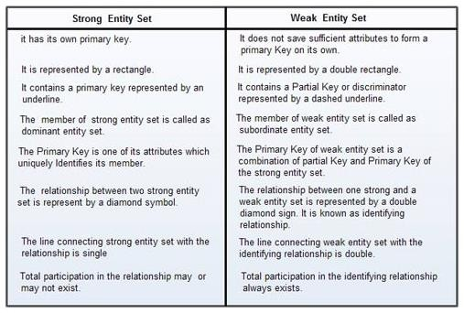
Weak and Strong Entity

Slide 13
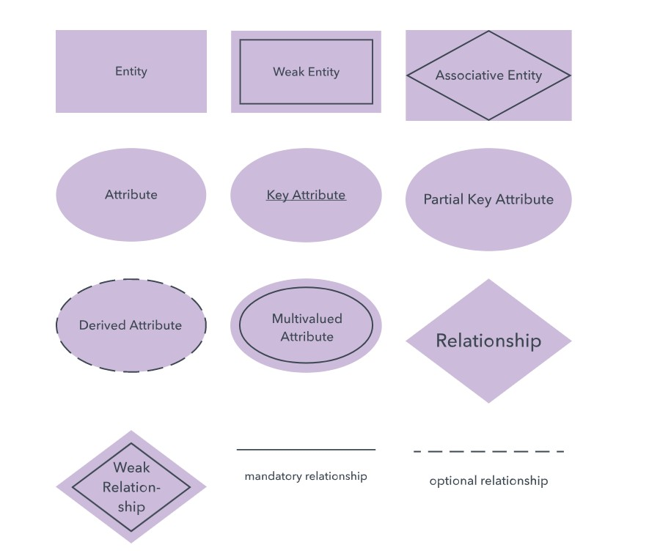
Notations in ER diagram
ENTITY RELATIONSHIP MODELLING

Slide 14
Diagramming Entities
In an E/R Diagram, an entity is usually drawn as a box with rounded corners
The box is labelled with the name of the class of objects represented by that entity
Lecturer
ID
Name
Course
Tutors
Student
Module
Studies

Slide 15
Attributes
Attributes are facts, aspects, properties, or details about an entity
Students have IDs, names,
courses, addresses, …
Modules have codes, titles,
credit weights, levels, …
Attributes have
A name
An associated entity
Domains of possible values
Values from the domain for each instance of the entity they are belong to

Slide 16
Types of Attributes
Simple attribute − Simple attributes are atomic values, which cannot be divided
further. For example, a student's phone number is an atomic value of 10 digits.
Composite attribute − Composite attributes are made of more than one simple attribute. For example, a student's complete name may have first_name and last_name.
Derived attribute − Derived attributes are the attributes that do not exist in the physical database, but their values are derived from other attributes present in the database.
For example, average_salary in a department should not be saved directly in the database, instead it can be derived. For another example, age can be derived from data_of_birth.

Slide 17
Types of Attributes
Single-value attribute − Single-value attributes contain single value.
For example − Social_Security_Number.
Multi-value attribute − Multi-value attributes may contain more than
one values.
For example, a person can have more than one phone number,
email_address, etc.

Slide 18
Diagramming Attributes
In an E/R Diagram attributes may be drawn as ovals
Each attribute is linked to its entity by a line
The name of the attribute is
written in the oval
Lecturer
ID
Name
Course
Tutors
Student
Module
Studies

Slide 19
Relationships
Relationships are an association between two or more entities
Each Student takes several Modules
Each Module is taught by a
Lecturer
Each Employee works for a single Department
Relationships have
A name
A set of entities that participate in them
A degree - the number of entities that participate (most have degree 2)
A cardinality ratio

Slide 20
Cardinality Ratios
Each entity in a relationship can participate in zero, one, or more than one instances of that relationship
This leads to 3 types of
relationship…
One to one (1:1)
Each lecturer has a unique office
One to many (1:M)
A lecturer may tutor many students, but each student has just one tutor
Many to many (M:M)
Each student takes several modules, and each module is taken by several students

Slide 21
Diagramming Relationships
Relationships are links between two entities
The name is given in a diamond box
The ends of the link show
cardinality
Lecturer
ID
Name
Course
Tutors
Student
Module
Studies
One
Many

Slide 22


Removing M:M Relationships
Many to many relationships are difficult to represent
We can split a many to many relationship into two one to many relationships
An entity represents the M:M relationship
Student
Student
Has
Studies
Enrolment
In
Module
Module

Slide 23
Making E/R Models
To make an E/R model you need to identify
Enitities
Attributes
Relationships
Cardinality ratios
from a description
General guidelines
Since entities are things or objects they are often nouns in the description
Attributes are facts or properties, and so are often nouns also
Verbs often describe relationships between entities

Slide 24
Example
A university consists of a number of departments. Each department offers several courses. A number of modules make up each course. Students enrol in a particular course and take modules towards the completion of that course.
Each module is taught by a lecturer from the appropriate department, and each lecturer tutors a group of students

Slide 25
Example - Entities
A university consists of a number of departments. Each department offers several courses. A number of modules make up each course. Students enrol in a particular course and take modules towards the completion of that course.
Each module is taught by a lecturer from the appropriate department, and each lecturer tutors a group of students

Slide 26
Example - Relationships
A university consists of a number of departments.
Each department offers several courses. A number of modules make up each course. Students enrol in a particular course and take modules towards the completion of that course. Each module is taught by a lecturer from the appropriate department, and each lecturer tutors a group of students

Slide 27
Example - E/R Diagram
Entities: Department, Course, Module, Lecturer, Student
Department
Course
Module
Lecturer
Student

Slide 28

Example - E/R Diagram
Each department offers several courses
Offers
Department
Course
Module
Lecturer
Student

Slide 29



Example - E/R Diagram
A number of modules make up each courses
Offers
Department
Course
Includes
Module
Lecturer
Student

Slide 30



Example - E/R Diagram
Students enrol in a particular course
Offers
Department
Course
Includes
Module
Lecturer
Enrols In
Student

Slide 31



Example - E/R Diagram
Students … take modules
Offers
Department
Course
Includes
Module
Lecturer
Takes
Enrols In
Student

Slide 32


Example - E/R Diagram
Each module is taught by a lecturer
Offers
Department
Course
Includes
Module
Teaches
Lecturer
Takes
Enrols In
Student

Slide 33
Example - E/R Diagram
a lecturer from the appropriate department
Offers
Department
Employs
Course
Includes
Module
Teaches
Lecturer
Takes
Enrols In
Student

Slide 34

Example - E/R Diagram
each lecturer tutors a group of students
Offers
Department
Employs
Course
Includes
Module
Teaches
Lecturer
Takes
Enrols In
Student
Tutors

Slide 35
Example - E/R Diagram
Offers
Department
Employs
Course
Includes
Module
Teaches
Lecturer
Takes
Enrols In
Student
Tutors

Slide 36
Entities and Attributes
Sometimes it is hard to tell if something should be an entity or an attribute
They both represent objects or facts about the world
They are both often represented by nouns in descriptions
General guidelines
Entities can have attributes but
attributes have no smaller parts
Entities can have relationships between them, but an attribute belongs to a single entity

Slide 37
Example
We want to represent information about products in a database. Each product has a description, a price and a supplier. Suppliers have addresses, phone numbers, and names. Each address is made up of a street address, a city, and a postcode.

Slide 38
Example - Entities/Attributes
Entities or attributes:
product
description
price
supplier
address
phone number
name
street address
city
postcode
Products, suppliers, and addresses all have smaller parts so we can make them entities
The others have no smaller parts and belong to a single entity

Slide 39
Example - E/R Diagram
Price
Description
Product
Street address
Name
Supplier
Address
City
Phone number
Postcode

Slide 40
Example - Relationships
Each product has a supplier
Each product has a single supplier but there is nothing to stop a supplier supplying many products
A many to one relationship
Each supplier has an address
A supplier has a single address
It does not seem sensible for two different suppliers to have the same address
A one to one relationship

Slide 41
Example - E/R Diagram
Price
Description
Product
Has A
Street address
Name
Supplier
Has A
Address
City
Phone number
Postcode

Slide 42
One to One Relationships
Some relationships between entities, A and B, might be redundant if
It is a 1:1 relationship between A and B
Every A is related to a B and
every B is related to an A
Example - the supplier- address relationship
Is one to one
Every supplier has an address
We don’t need addresses that
are not related to a supplier

Slide 43
Redundant Relationships
We can merge the two entities that take part in a redundant relationship together
They become a single entity
The new entity has all the
attributes of the old one
a
x
b
A
B
y
c
z
a
x
b
AB
y
c
z

Slide 44
Example - E/R Diagram
Price
Description
Product
Has A
Name
Supplier
City
Phone number
Postcode
Street address

Slide 45
Making E/R Diagrams
From a description of the requirements identify the
Entities
Attributes
Relationships
Cardinality ratios of the
relationships
Draw the E/R diagram and then
Look at one to one relationships as they might be redundant
Look at many to many relationships as they might need to be split into two one to many links

Slide 46
Debugging Designs
With a bit of practice E/R diagrams can be used to plan queries
You can look at the diagram and figure out how to find useful information
If you can’t find the information you need, you may need to change the design
Student
How can you find a list of students who are enrolled in Database systems?
Has
Enrolment
In
Module

Slide 47
Debugging Designs
ID
(3) For each instance of Enrolment in the result of (2) find the corresponding Student
Student
Name
Has
ID
(2) Find instances of the Enrolment entity
with the same Code as the result of (1)
Enrolment
Code
In
Code
(1) Find the instance of the Module entity with title ‘Database Systems’
Module
Title

Slide 48
TASK
“A database will be made to store information about patients in a hospital. On arrival, each patient’s personal details (name, address, and telephone number) are recorded where possible, and they are given an admission number. They are then assigned to a particular ward (Accident and Emergency, Cardiology, Oncology, etc.). In each ward there are a number of doctors and nurses. A patient will be treated by one doctor and several nurses over the course of their stay, and each doctor and nurse may be involved with several patients at any given time.”

